Slide 1
INCOME DYNAMICS in fintechs - worldwide
Starring : Basak & Robin

Slide 2
Description of your dataset
Our data set information is a breakdown of salaries in fintechs companies where GAFAMs are heavily represented
62K+ lines
The breakdown is organized with some interesting subsets, mainly:
Position of the Employees
Their Yearly Income
Their Experience, both at their actual position and within the company they work for
Their Location
And some more others like Education, Gender, Race

Slide 3
The Challenges we faced
Keeping the code clean when modifying the data - Usually after discovering outliers, or figuring out we don’t need this row or columns, which had dependencies later in the code
Identifying outliers and getting rid of them was not always simple
Correcting the .CSV to get rid of special characters to process in my SQL
THE BIG ONE : Not being able to import 57K+ lines in mySQL => feeding them directly from python code into SQL with PYMYSQL.CURSORS

Slide 4
OUR OVERALL Process
Import, Clean, Export, Exploit
The process was quite clear from the beginning as it was such a straightforward exercise
It left us with a very small room for interpretation or getting lost which was satisfying

Slide 5
#Cleaning
Unnecessary columns have been removed. Required columns (like country) were added to data frame.
All columns name were renamed.
Empty cells, duplicates were checked and irrelevant ones have been removed.
Outliers were identified with dataplots and they have been removed with quantile method. Also "nlargest" function has been removed too.
Typos in job title have been fixed and unique names were used for all job titles (like: Soft Engineer converted to the Software Engineer)
Missing salary, bonus and compensation data was replaced with the average of the same job title salary data

Slide 6
#Manipulating
Missing salary, bonus and compensation data was replaced with the average of the same job title salary data.
#Exporting
New data frame has been exported as a CSV file to record.
pymysql.cursors was used to send the clean data to mySQL Benchmark because manual csv export didn't work properly.
#Results
Results have been generated with mySQL to analyze the differences between job titles, genders, races, experiences, etc...

Slide 7
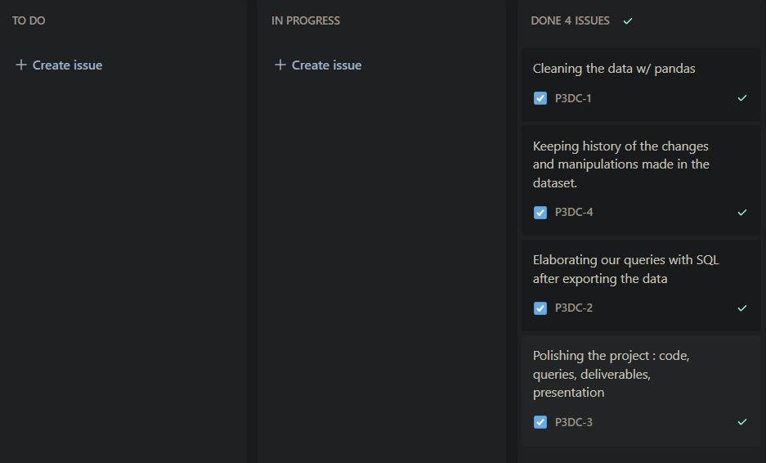

Slide 8
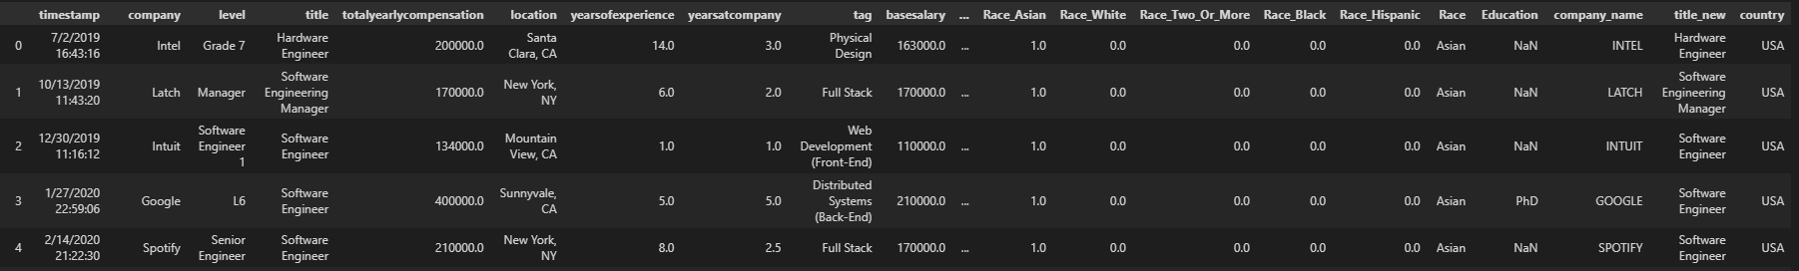
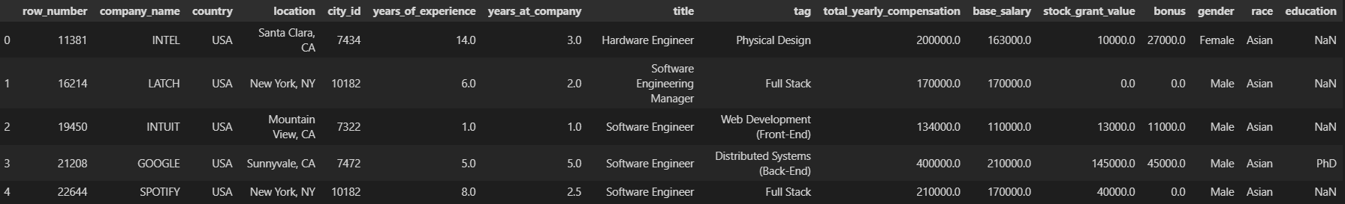
Comparison of the initial and final datasets
From 20 columns – trimmed it down to 16 for the final data set

Slide 9
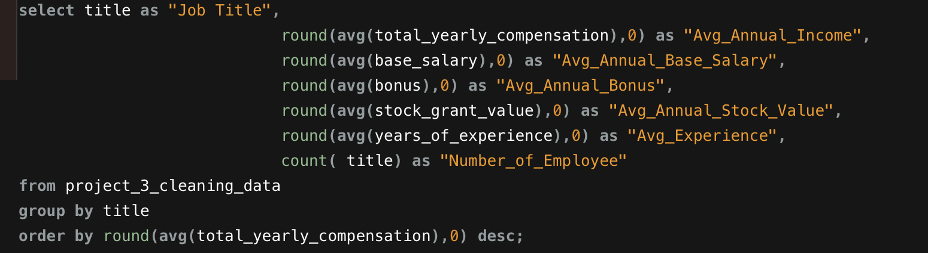
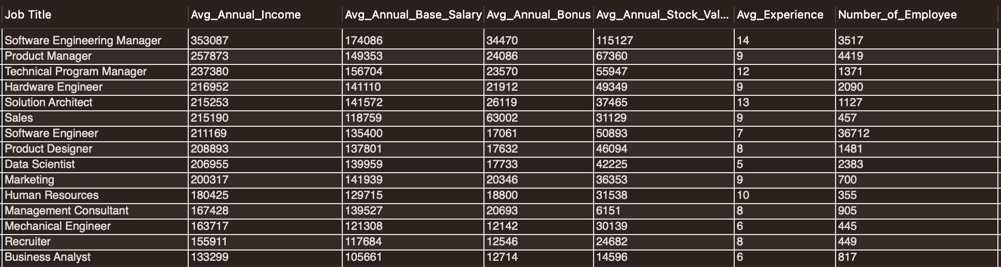
Job Titles & Income Relationship
Notes:
SE : Earn usually significantly more than other positions for the same experience. Data scientist are not far !! TECH ++

Slide 10
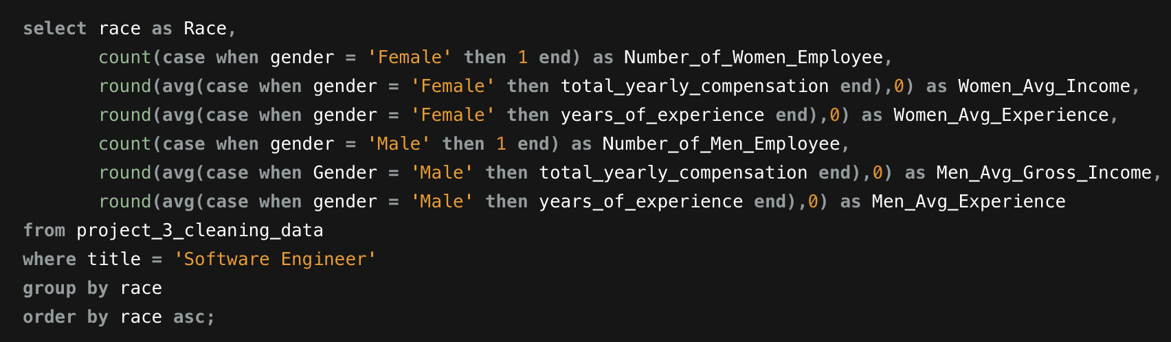
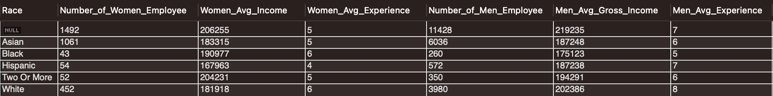
Sofware Engineers Statistics
Notes:
High number of Asian women SE relative to total (men + women). Low number of Hispanic women SE relative to total. 50% of data missing on race so this is a borderline comparison, be cautious if we had to exploit it.

Slide 11
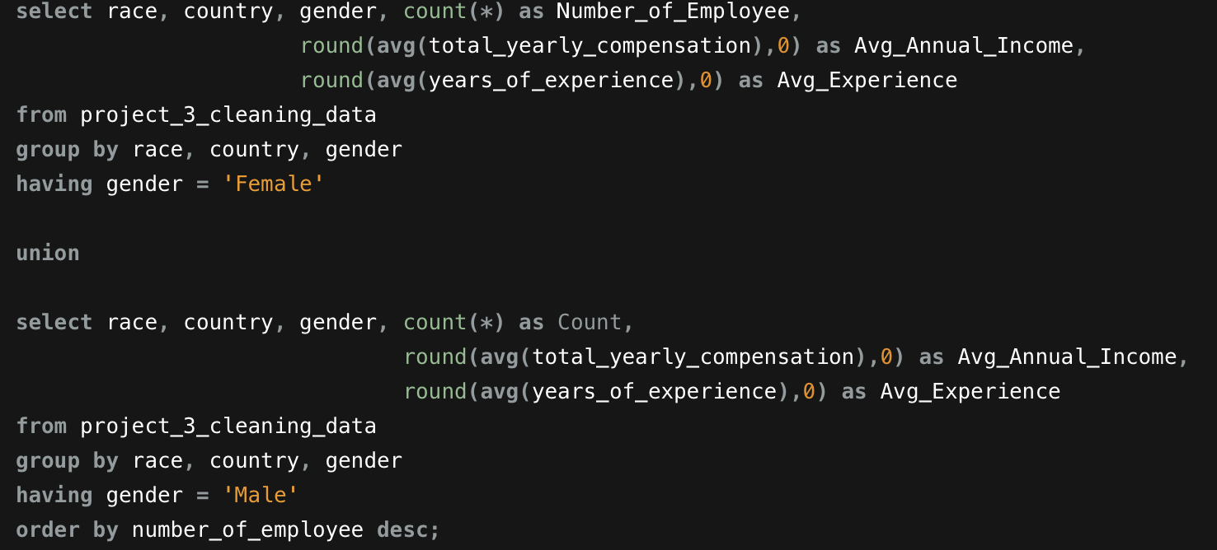
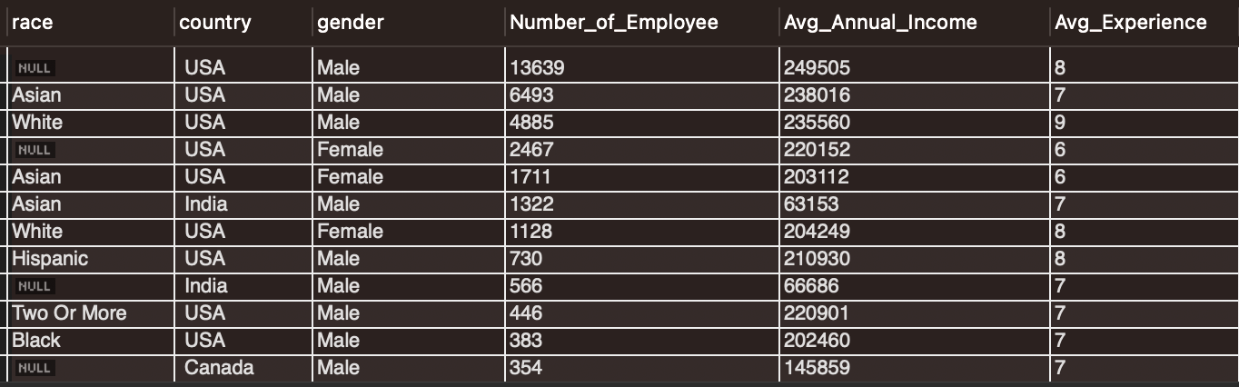
Gender, Race and Income Statistics for Countries
Notes:
31118 – 34002 – 26173 – 36692 – 33852 – 9021 – 25531 – 25241 – 9526 – 31727 – 28922 – 20837 Women are roughly representing 25% of the workforce. Their salarie tend to be lower than men. Indian people are not payed well.

